Slide 1
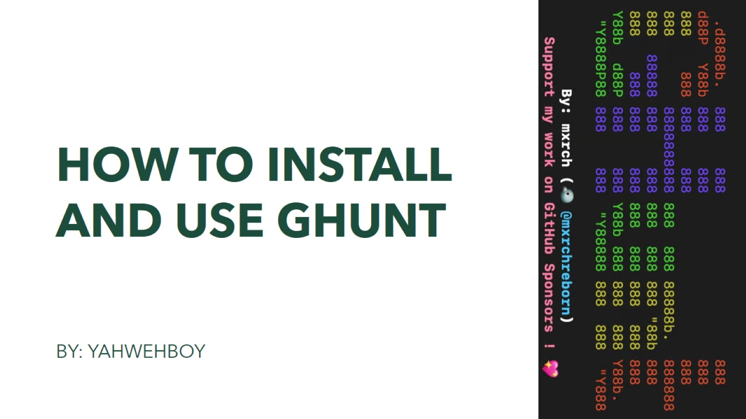
HOW TO INSTALL AND Use ghunt

Slide 2
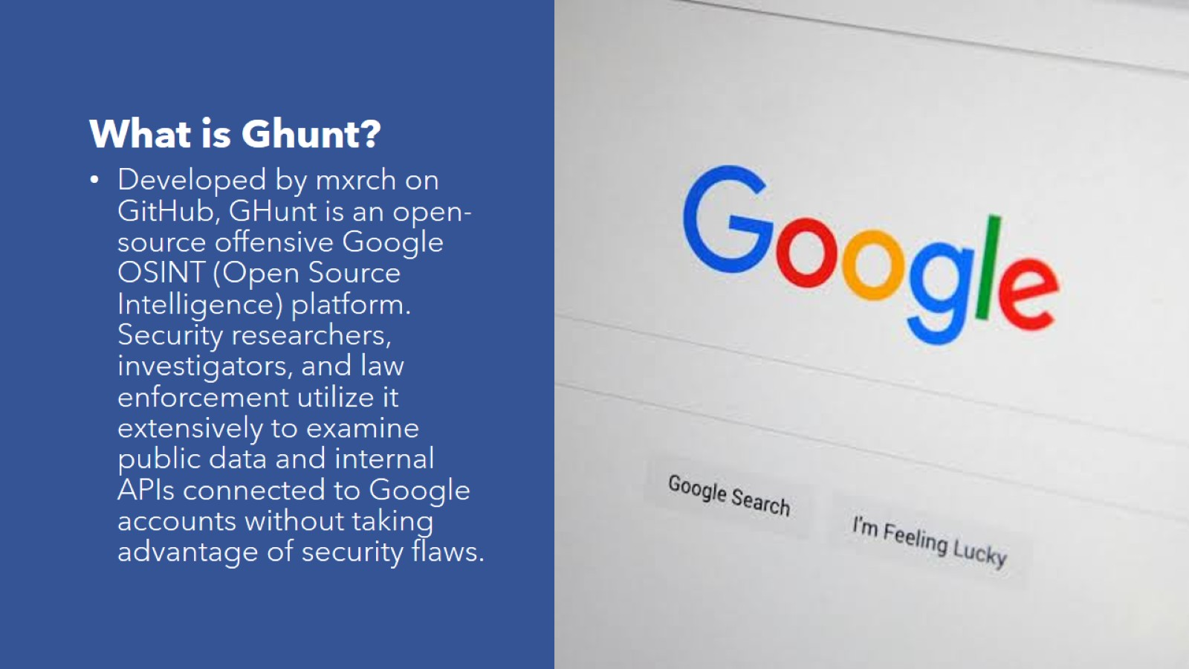
What is Ghunt?

Slide 3

How to install GHunt

Slide 4
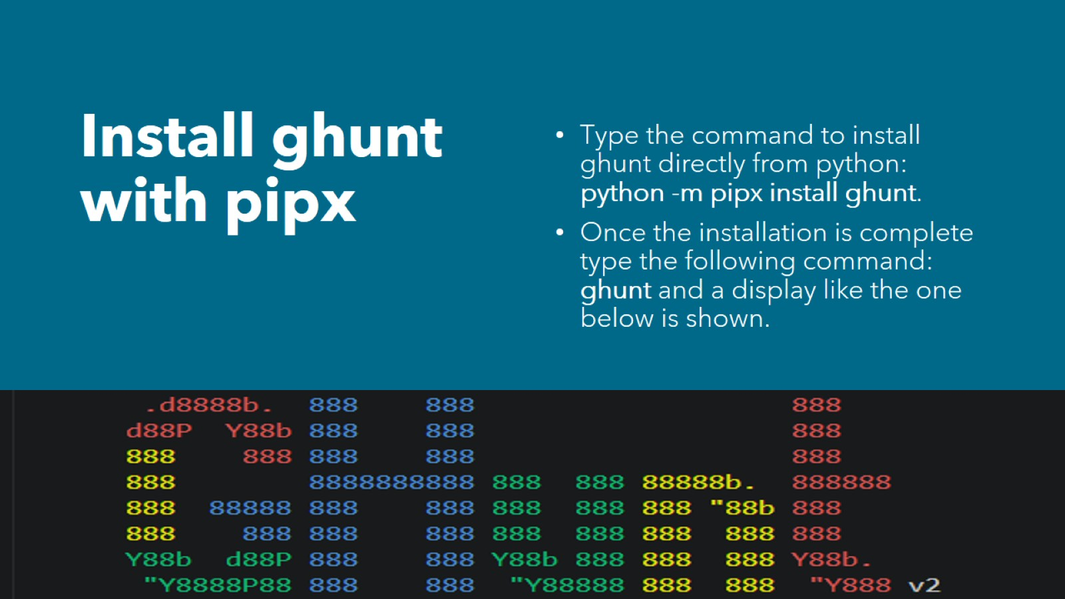
Install ghunt with pipx

Slide 5
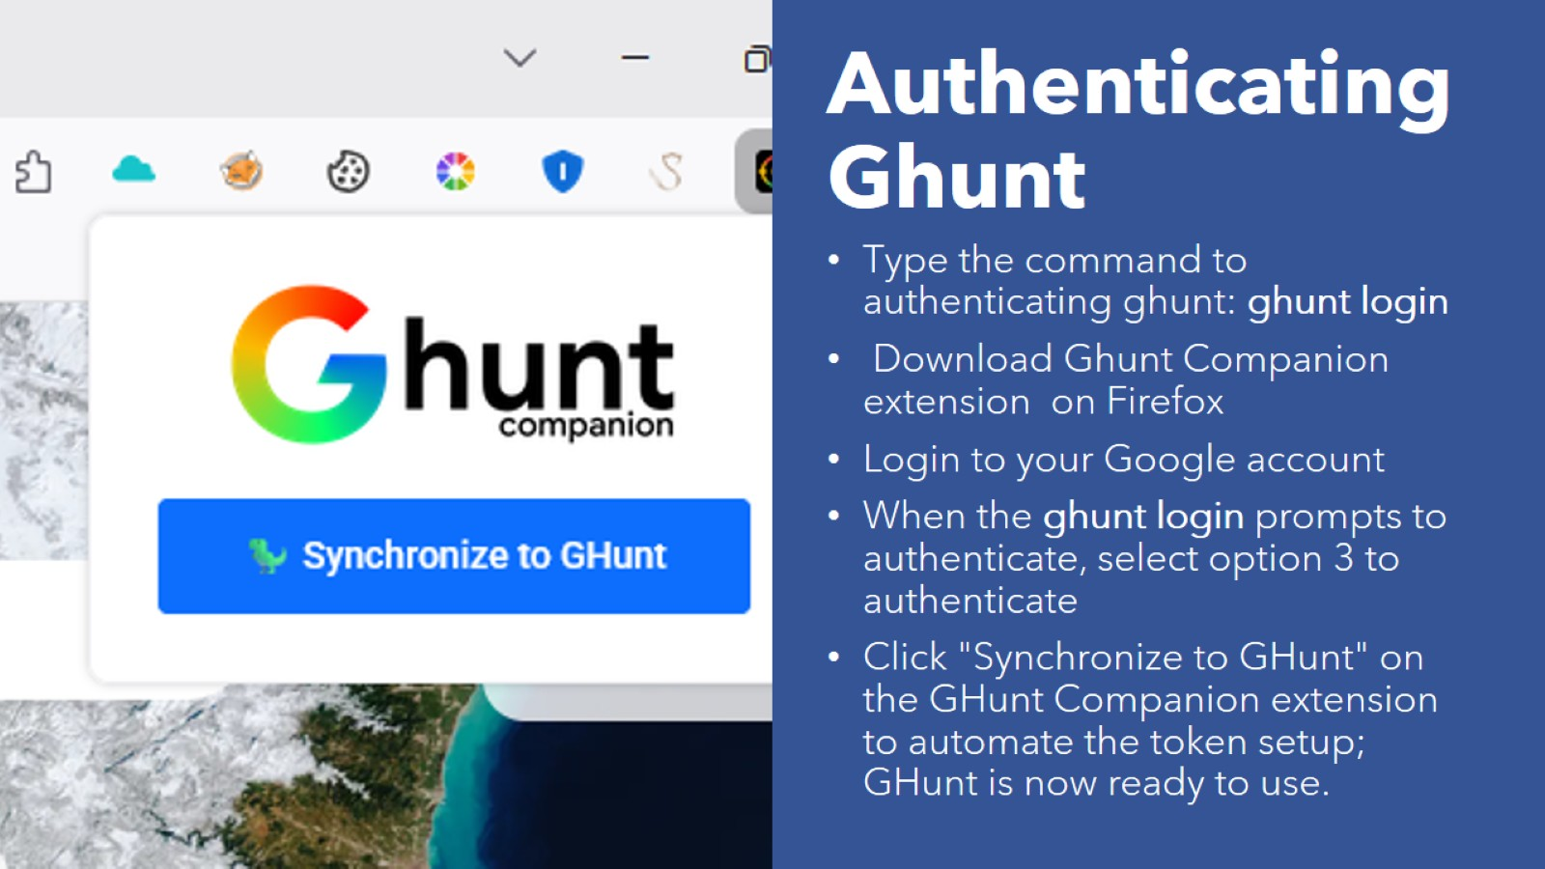
Authenticating Ghunt

Slide 6
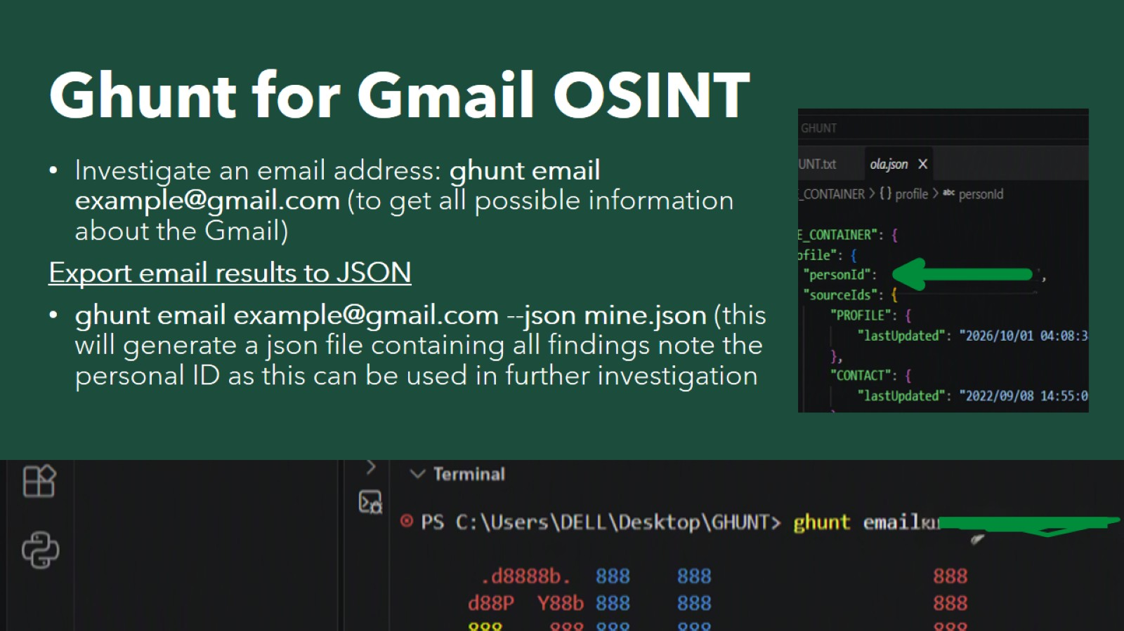
Ghunt for Gmail OSINT

Slide 7
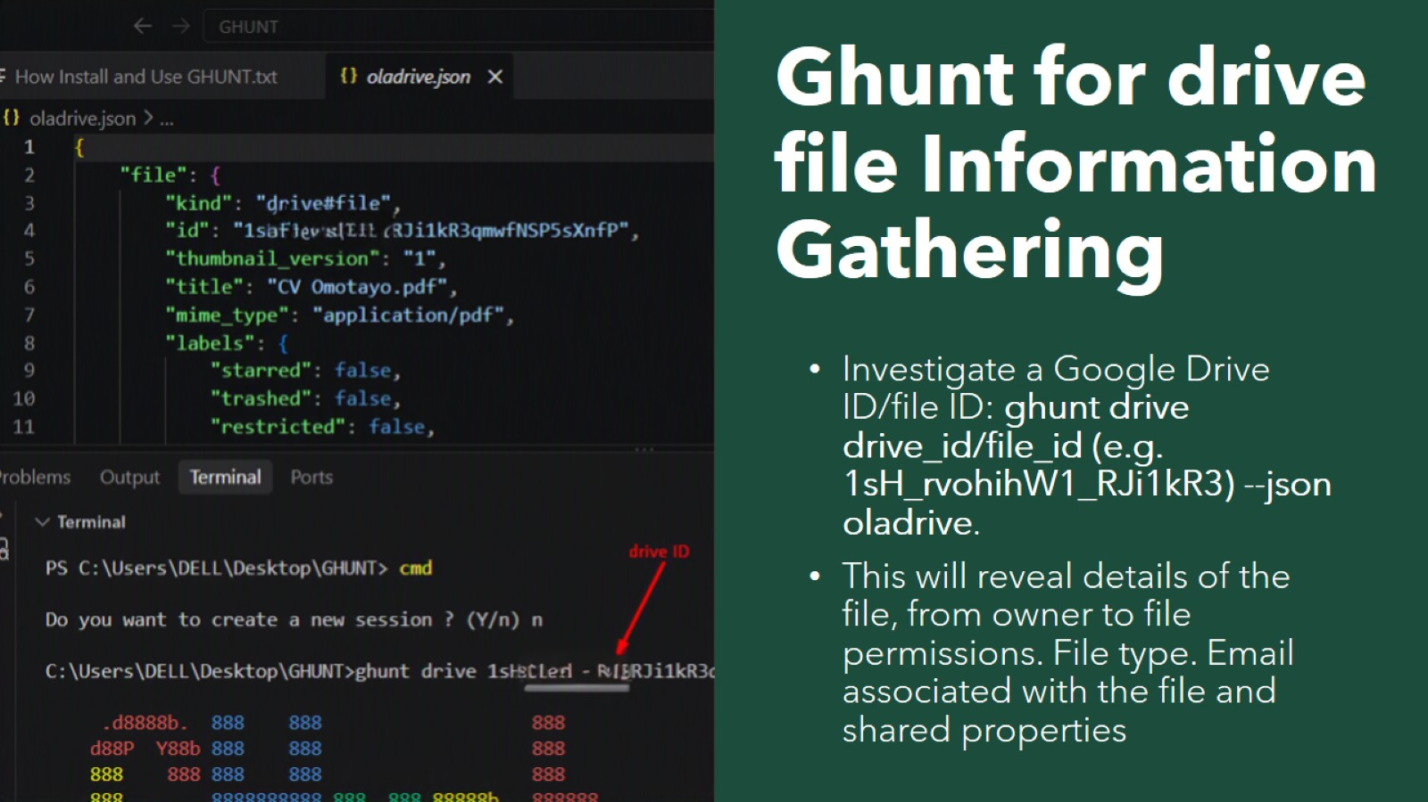
Ghunt for drive file Information Gathering

Slide 8
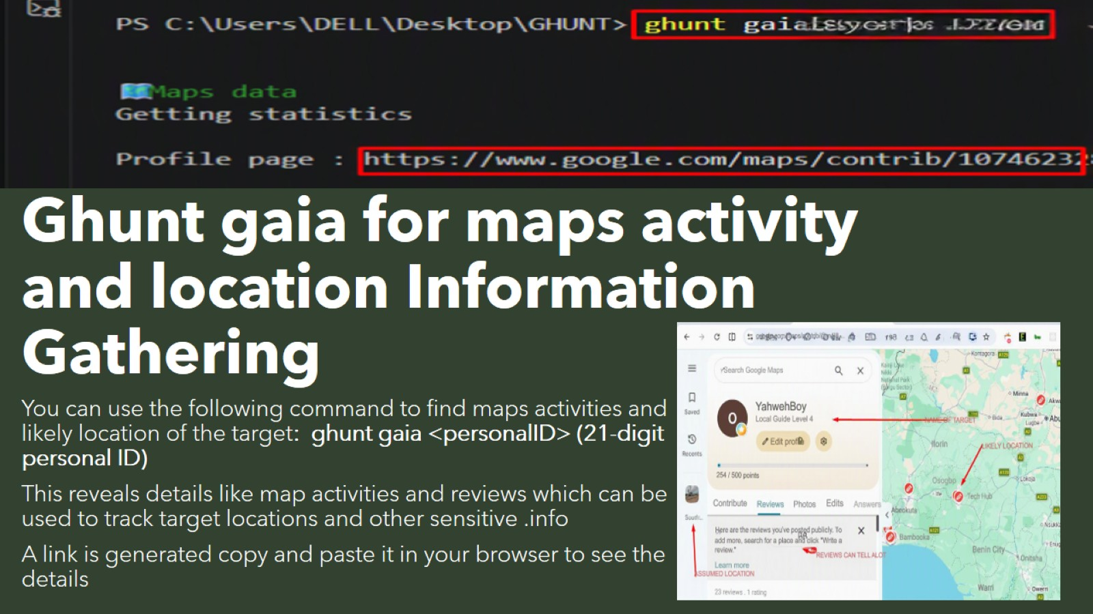
Ghunt gaia for maps activity and location Information Gathering

Slide 9
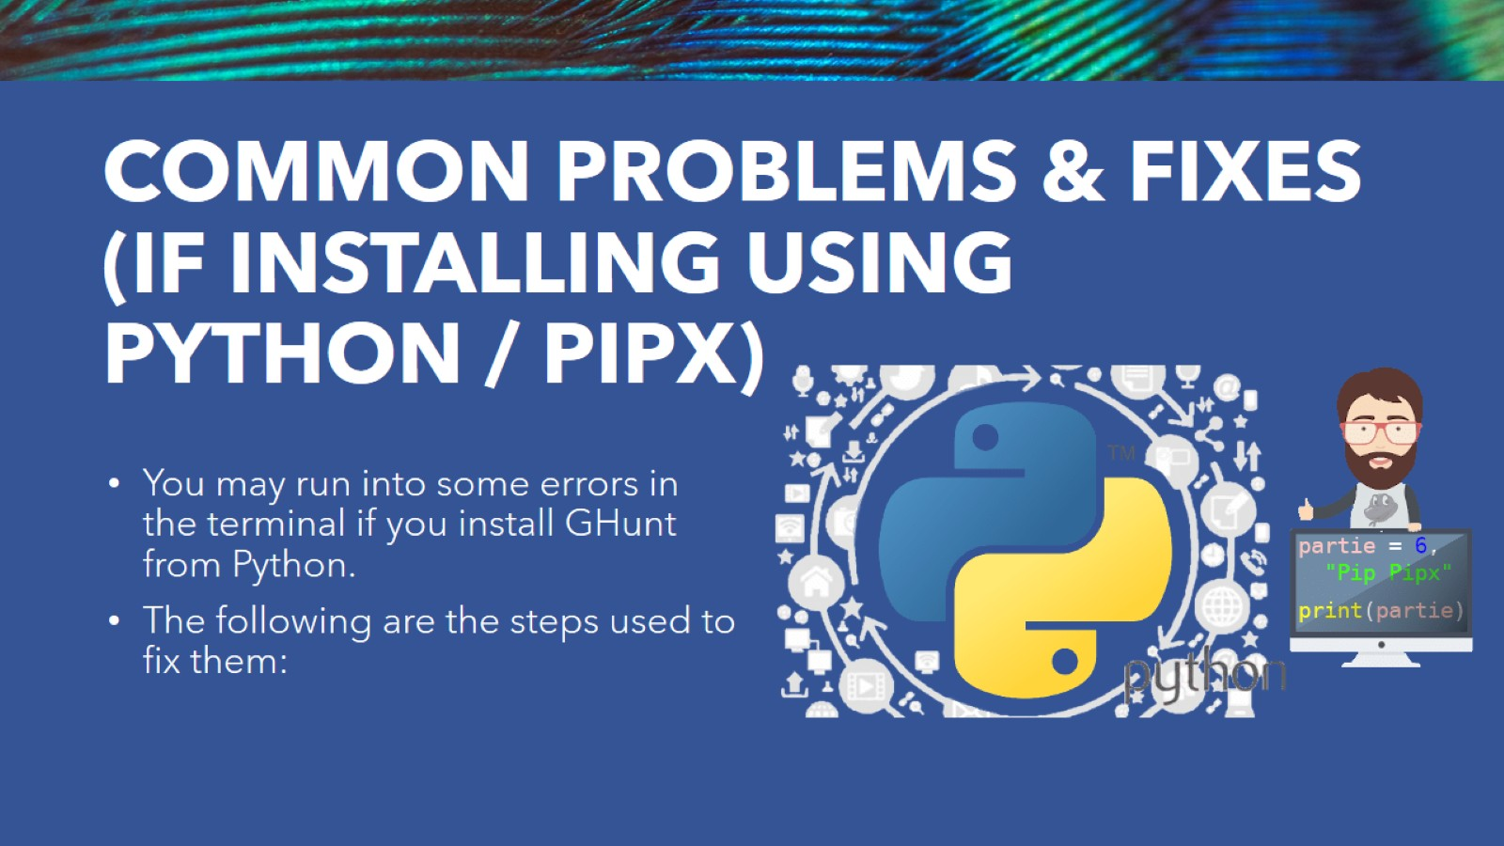
COMMON PROBLEMS & FIXES (IF INSTALLING USING PYTHON / PIPX)

Slide 10
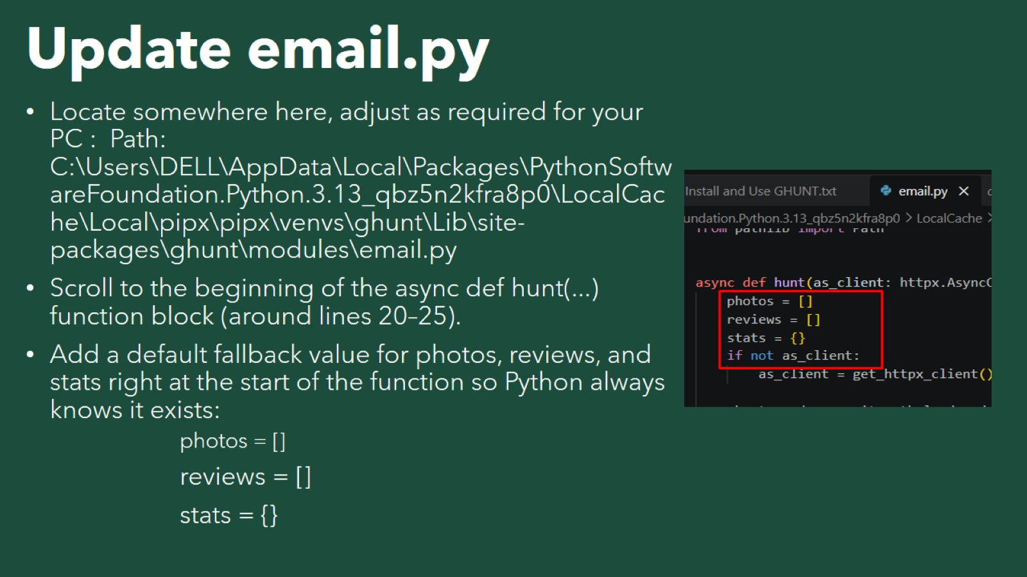
Update email.py

Slide 11
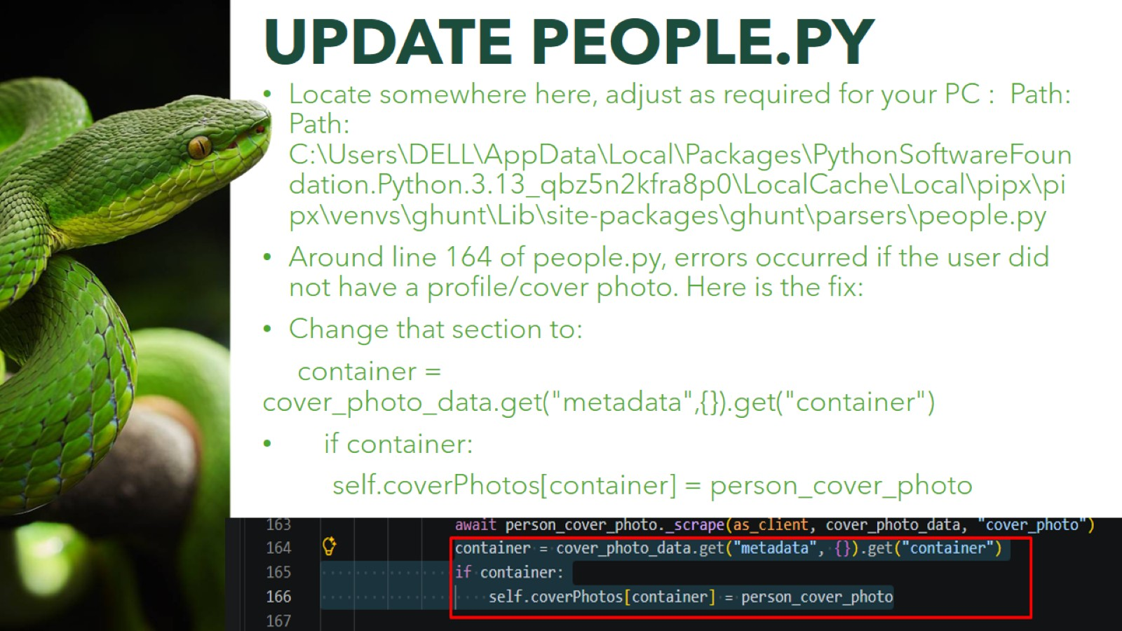

Slide 12
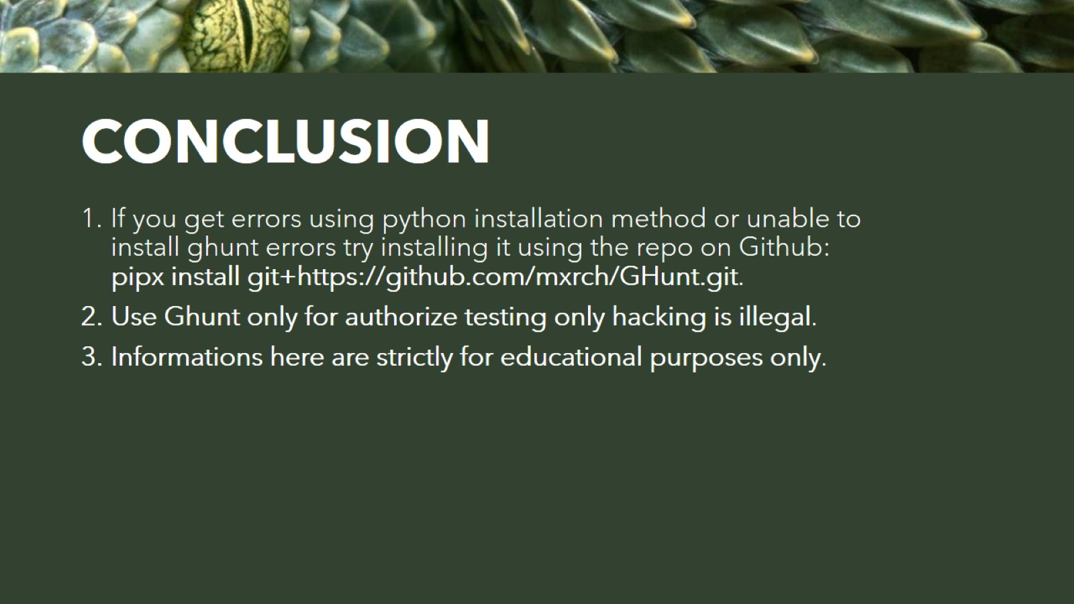
CONCLUSION

